Slide 1
Touching the cloud
October 2018
timisoara

Slide 2

Agenda
Cloud information
Red Hat Openshift
Live coding Openshift
Serverless
AWS Services
AWS Serverless live coding

Slide 3
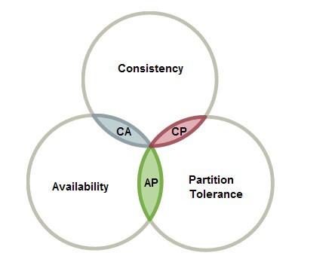
Distributed systems
Sharing of tasks by different computers which may be in different parts of the globe.
Distributed systems made possible what Cloud is today
Advantages
Performance
Reliability
Scalability
Disadvantages
Synchronization
Notes:
Vertical Scaling VS Horizontal Scaling
CAP Theorem image

Slide 4

What is cloud
Simply put, cloud computing is the delivery of computing services—servers, storage,
databases, networking, software, analytics, intelligence and more—over the Internet
Types of Cloud Computing
Public
Private
Hybrid
Types of Cloud Services
Infrastructure as a service (IaaS)
Platform as a service (PaaS)
Serverless computing
Software as a service (SaaS)
Notes:
Infrastructure as a Service provides you with the highest level of flexibility and management control over your IT resources and is most similar to existing IT resources that many IT departments and developers are familiar with today.
Platforms as a service remove the need for organizations to manage the underlying infrastructure (usually hardware and operating systems) and allow you to focus on the deployment and management of your applications.
Software as a Service provides you with a completed product that is run and managed by the service provider.

Slide 5

Why cloud
Trade capital expense for variable expense
Benefit from massive economies of scale
Stop guessing capacity
Increase speed and agility
Stop spending money on running and maintaining data
centers
Go global in minutes
Notes:
Trade capital expense for variable expense
Instead of having to invest heavily in data centers and servers before you know how you’re going to use them, you can only pay when you consume computing resources, and only pay for how much you consume.

Slide 6
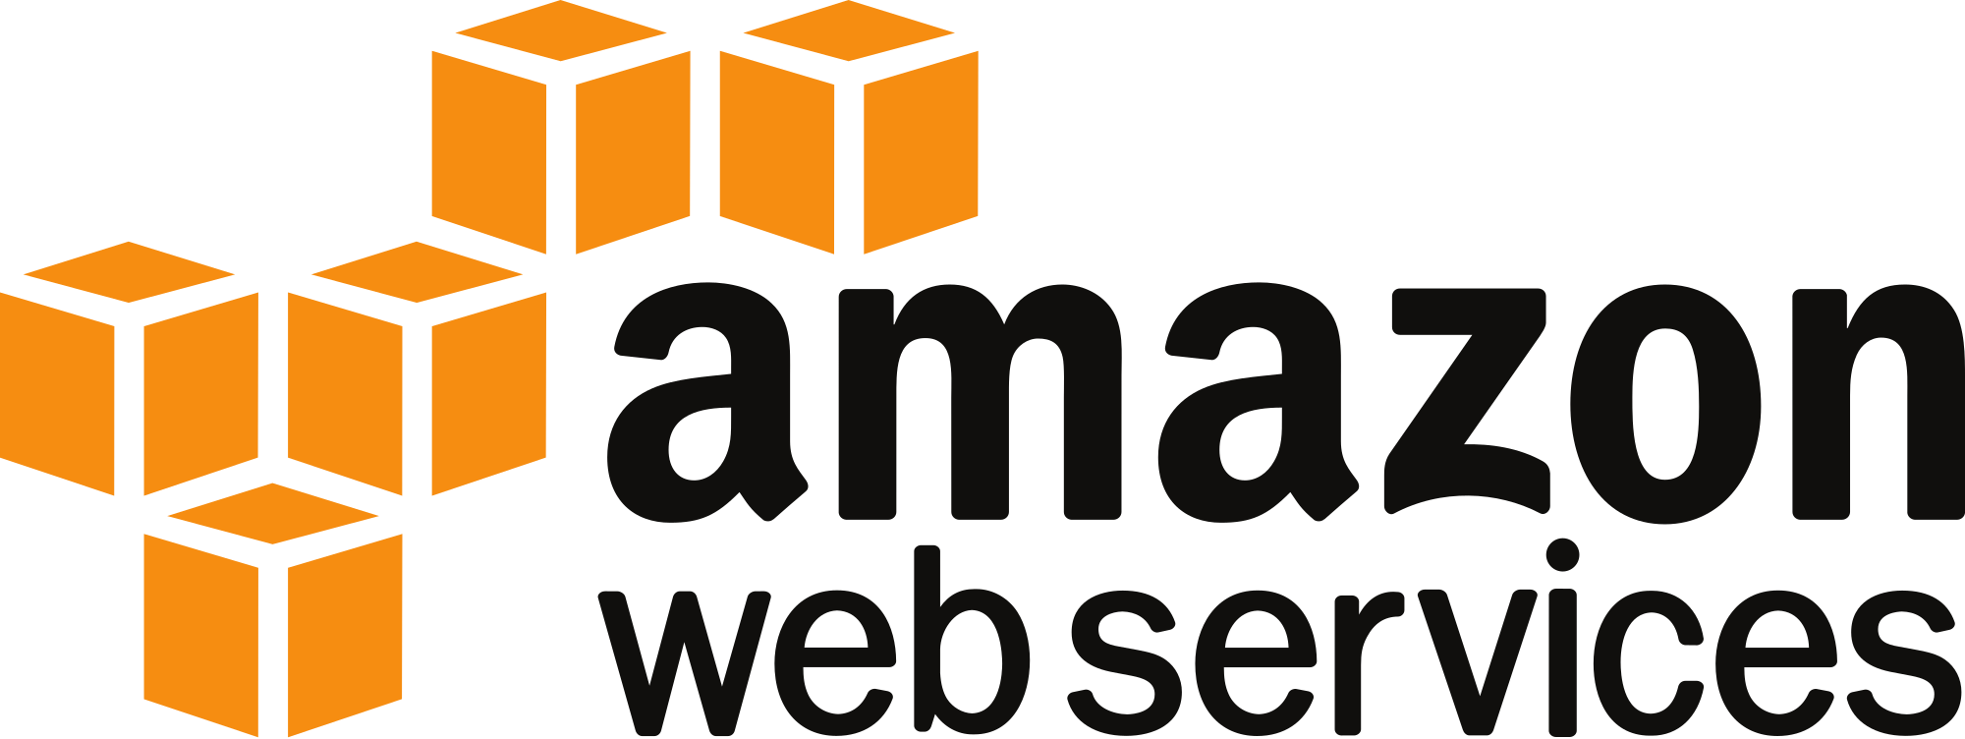
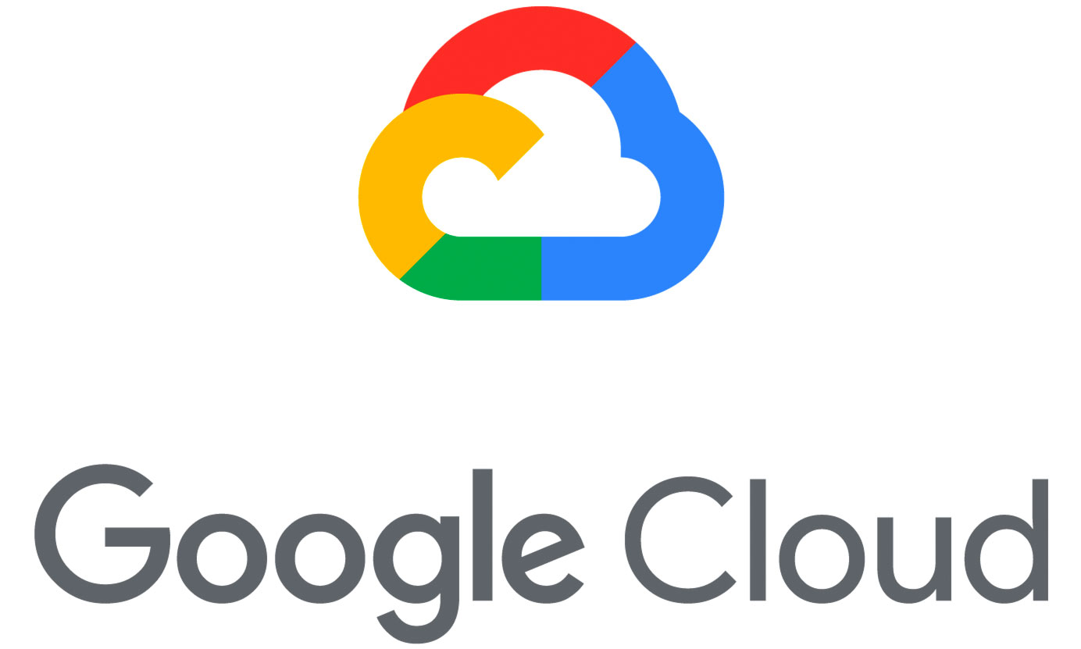
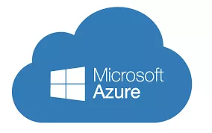
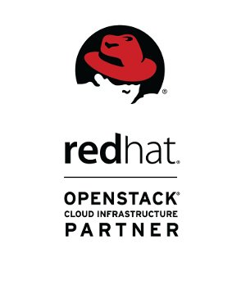

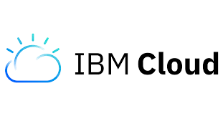
Where is cloud

Slide 7

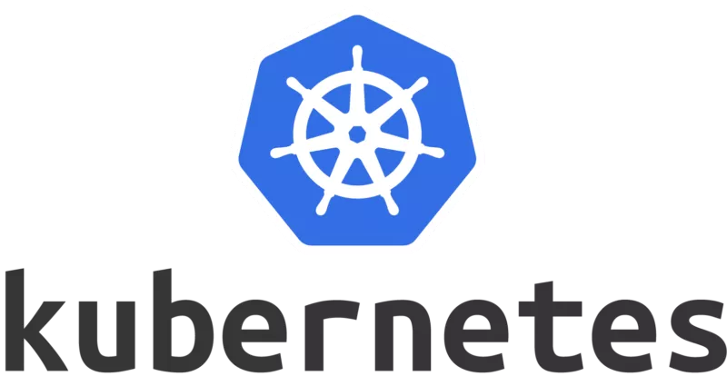
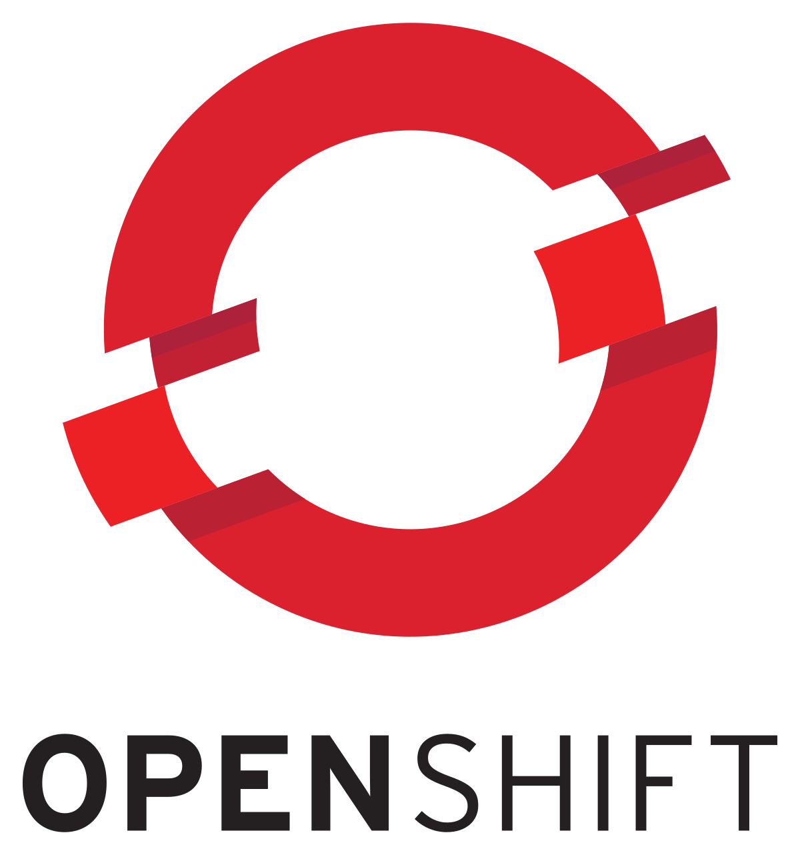
What is Openshift
+
=
Notes:
Docker is a computer program that performs operating-system-level virtualization, also known as "containerization“
A Docker image is a file, comprised of multiple layers, used to execute code in a Docker container.
Kubernetes is an open-source container-orchestration system for automating deployment, scaling and management of containerized applications. It was originally designed by Google and is now maintained by the Cloud Native Computing Foundation
Its development and design are heavily influenced by Google's Borg system,^{[7][8]} and many of the top contributors to the project previously worked on Borg. The original codename for Kubernetes within Google was Project Seven, a reference to Star Trek character Seven of Nine that is a 'friendlier' Borg.^{[9]} The seven spokes on the wheel of the Kubernetes logo are a nod to that codename.

Slide 8

Openshift purpose
Openshift for Developers
Build with speed, deploy at scale
Self-service, on-demand application stacks
Code and push
Streamline the delivery process
Openshift for Operations
Consistency and stability, everywhere you operate
Continuous Security
Unified Operations
Proactive, not reactive

Slide 9
Live coding
Notes:
9

Slide 10
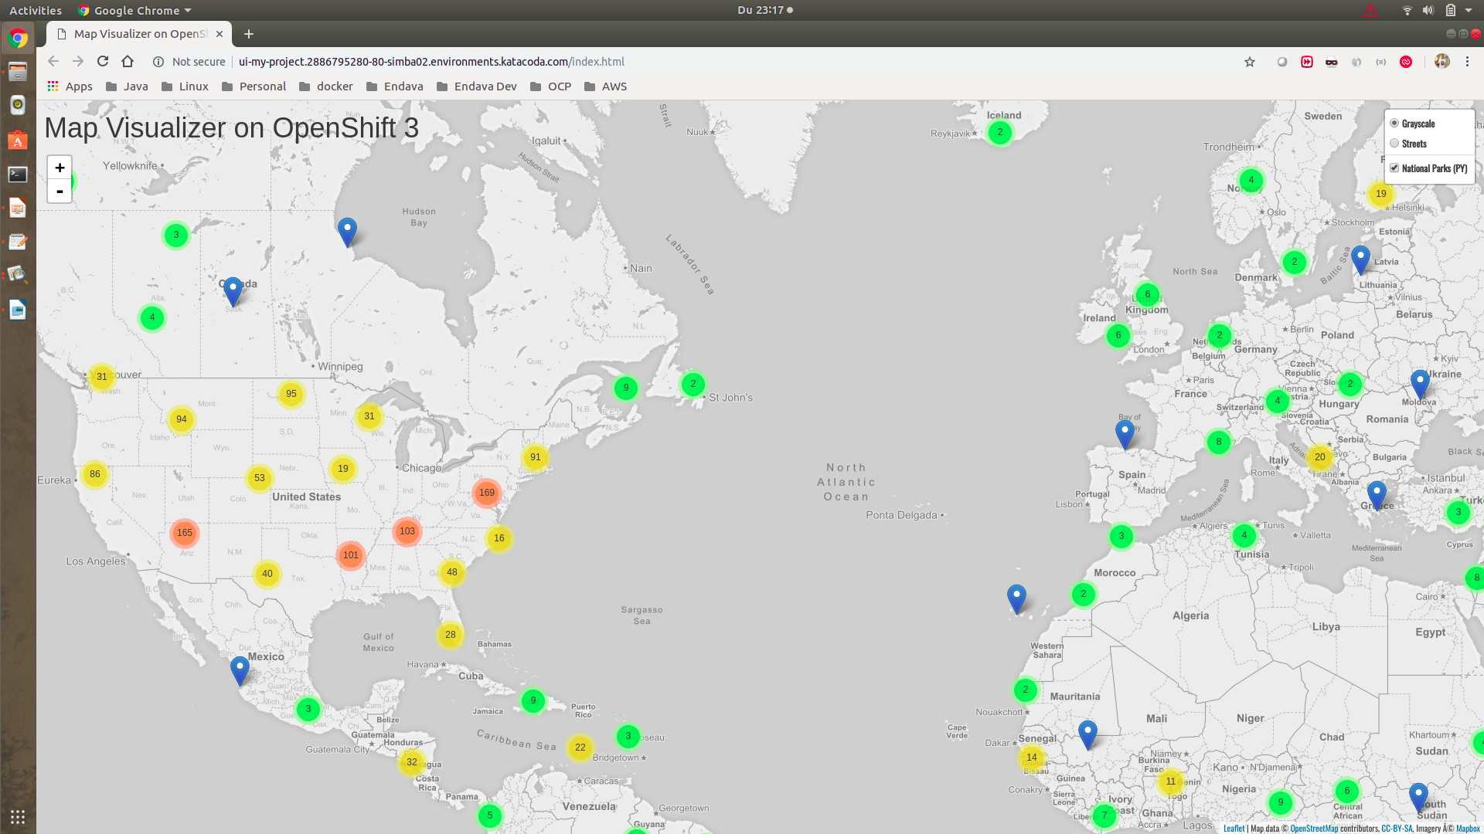
Notes:
10

Slide 11

Serverless computing
Build and run applications without thinking about servers
Why use serverless computing?
Developers can focus on their core product instead of worrying about
managing and operating servers or runtimes
Benefits of serverless computing
no server management
flexible scaling
automated high availability
costs
Notes:
Serverless applications don't require you to provision, scale, and manage any servers. You can build them for nearly any type of application or backend service, and everything required to run and scale your application with high availability is handled for you.

Slide 12
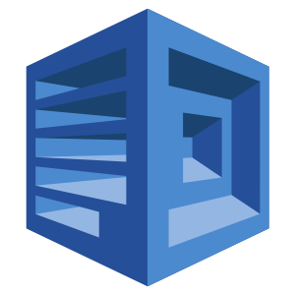
Amazon polly
Turn text into lifelike speech using deep learning
Benefits
natural sounding voices
store & redistribute speech
real-time streaming
customize & control speech output
low cost
Notes:
Amazon Polly is a service that turns text into lifelike speech, allowing you to create applications that talk, and build entirely new categories of speech-enabled products. Amazon Polly is a Text-to-Speech service that uses advanced deep learning technologies to synthesize speech that sounds like a human voice.
With dozens of lifelike voices across a variety of languages, you can select the ideal voice and build speech-enabled applications that work in many different countries.

Slide 13
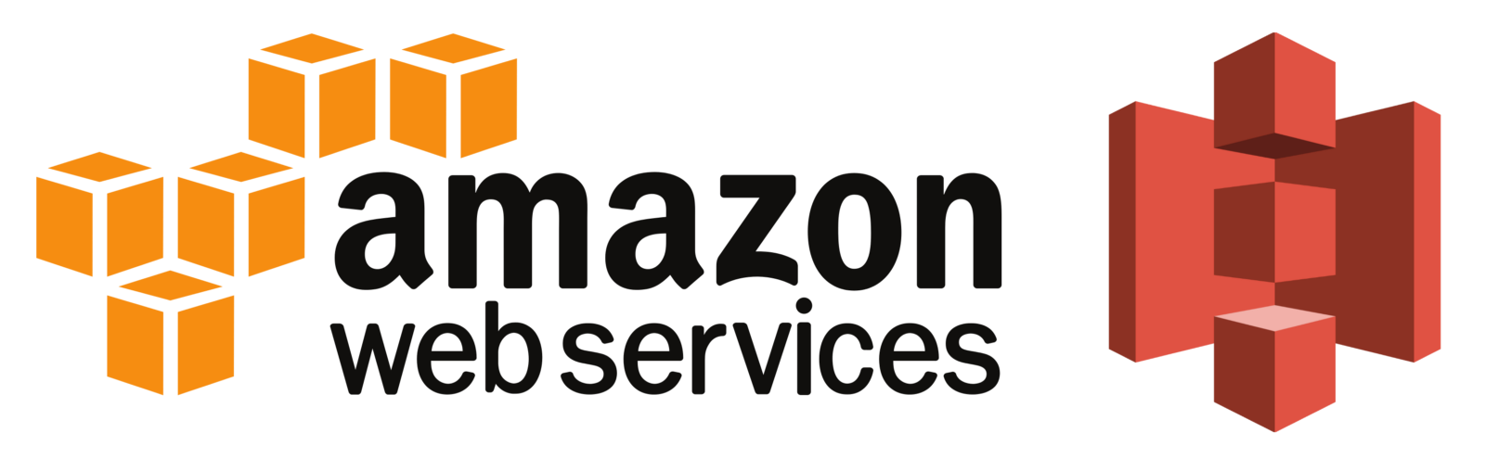
Amazon S3
Object storage built to store and retrieve any amount of data from anywhere
Benefits
durability, availability and scalability
comprehensive security
flexible management
most supported by partners, vendors and AWS services
easy, flexible data transfer
Notes:
Companies today need the ability to simply and securely collect, store, and analyze their data at a massive scale. Amazon S3 is object storage built to store and retrieve any amount of data from anywhere – web sites and mobile apps, corporate applications, and data from IoT sensors or devices. It is designed to deliver 99.999999999% durability, and stores data for millions of applications used by market leaders in every industry. S3 provides comprehensive security and compliance capabilities that meet even the most stringent regulatory requirements. It gives customers flexibility in the way they manage data for cost optimization, access control, and compliance. S3 provides query-in-place functionality, allowing you to run powerful analytics directly on your data at rest in S3. And Amazon S3 is the most supported cloud storage service available, with integration from the largest community of third-party solutions, systems integrator partners, and other AWS services.

Slide 14
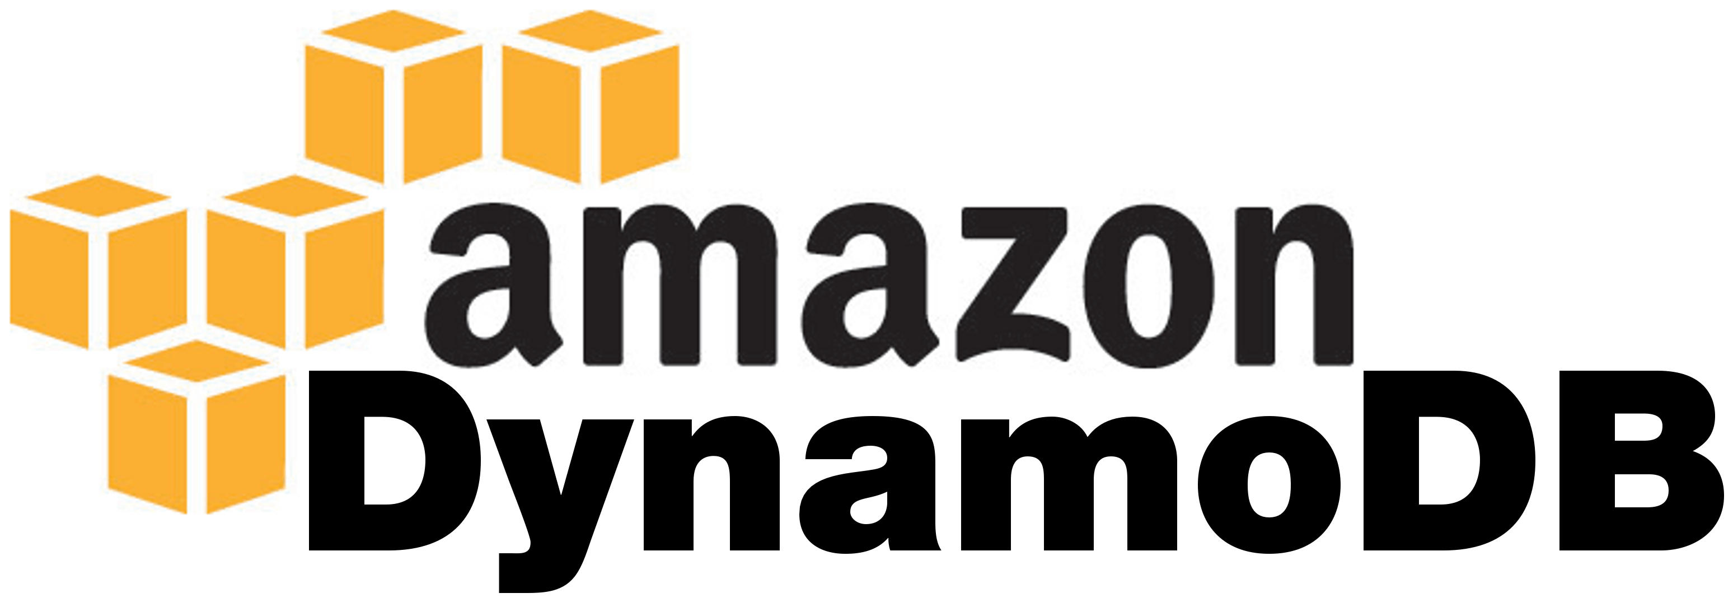
Amazon Dynamo DB
Nonrelational database that delivers reliable performance at any scale.
Create a new table for your application and let DynamoDB handle the rest.
Benefits
performance at scale
fully managed
enterprise-ready
Notes:
It's a fully managed, multi-region, multi-master database that provides consistent single-digit millisecond latency, and offers built-in security, backup and restore, and in-memory caching.

Slide 15

Amazon Lambda
Run code without thinking about servers.
Pay only for the compute time you consume.
Benefits
no servers to manage
continuous scaling
subsecond metering
Notes:
AWS Lambda lets you run code without provisioning or managing servers. You pay only for the compute time you consume - there is no charge when your code is not running.
With Lambda, you can run code for virtually any type of application or backend service - all with zero administration. Just upload your code and Lambda takes care of everything required to run and scale your code with high availability. You can set up your code to automatically trigger from other AWS services or call it directly from any web or mobile app.
1M requests 0.020$

Slide 16

Amazon API GATEWAY
Create, maintain, and secure APIs at any scale
A “front door” for applications to access data, business logic, or functionality from your back-end services.
Benefits
Low cost and efficient
Performance at any scale
Easily monitor API activity
Flexible security controls
Run your APIs without servers
Create restful API endpoints for existing services
Notes:
Amazon API Gateway is a fully managed service that makes it easy for developers to create, publish, maintain, monitor, and secure APIs at any scale. With a few clicks in the AWS Management Console, you can create an API that acts as a “front door” for applications to access data, business logic, or functionality from your back-end services, such as workloads running on Amazon Elastic Compute Cloud (Amazon EC2), code running on AWS Lambda, or any web application.
Amazon API Gateway handles all the tasks involved in accepting and processing up to hundreds of thousands of concurrent API calls, including traffic management, authorization and access control, monitoring, and API version management. Amazon API Gateway has no minimum fees or startup costs. You pay only for the API calls you receive and the amount of data transferred out.

Slide 17

Amazon SNS
Decouple and scale microservices, distributed systems, and serverless
Applications
Use topics to decouple message publishers from subscribers, fan-out messages
to multiple recipients at once, and eliminate polling in your applications.
Push messages to:
Amazon Simple Queue Service (SQS)
AWS Lambda functions
HTTP endpoints
Notes:
Amazon Simple Notification Service (SNS) is a highly available, durable, secure, fully managed pub/sub messaging service that enables you to decouple microservices, distributed systems, and serverless applications. Amazon SNS provides topics for high-throughput, push-based, many-to-many messaging. Using Amazon SNS topics, your publisher systems can fan out messages to a large number of subscriber endpoints for parallel processing, including Amazon SQS queues, AWS Lambda functions, and HTTP/S webhooks. Additionally, SNS can be used to fan out notifications to end users using mobile push, SMS, and email.

Slide 18
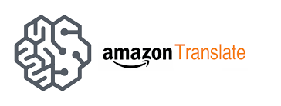
Amazon Translate
Natural and accurate language translation
Neural machine translation service that delivers:
fast
high-quality language translation
affordable
Benefits
Highly Accurate & Continuously Learning
Easy to Integrate into Your Applications
Scalable
Notes:
Amazon Translate is a neural machine translation service that delivers fast, high-quality, and affordable language translation. Neural machine translation is a form of language translation automation that uses deep learning models to deliver more accurate and more natural sounding translation than traditional statistical and rule-based translation algorithms. Amazon Translate allows you to localize content - such as websites and applications - for international users, and to easily translate large volumes of text efficiently.

Slide 19

Start from vision
A computer on every desk and in every home running Microsoft software
Bill Gates 1980
Every startup, application should start from a vision
Our vision:
Transform any book or article into audio and translate to other languages

Slide 20
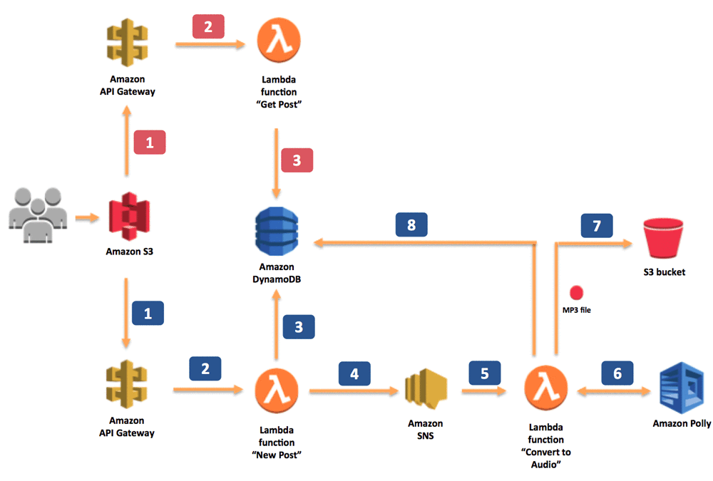
Text to speech architecture

Slide 21
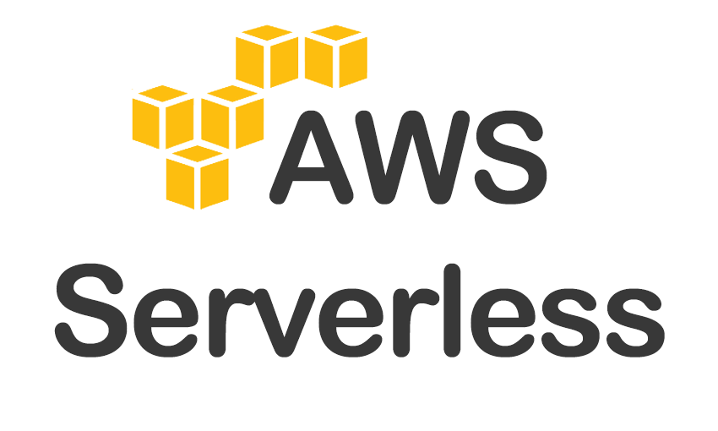
Live coding
Notes:
21

Slide 22
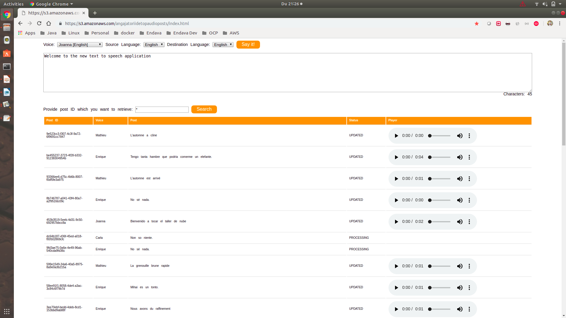
Notes:
22

Slide 23
Next Steps
Convert real time audio into another language audio using Amazon Transcribe
Could be a very good fit to IoT:
smart headset
smartphone application
smart glasses
Make it production ready
Automate resource allocation

Slide 24

Why you should learn cloud
Why start learning and use Cloud right now
It is the best option for creating a startup
Perfect suited to test new ideas/solutions
It is already happening, better embrace change than resist
Costs
Focus on your business and reuse existing services
Access to services that would be almost impossible to create
Evolve along with the Cloud provider with minimal or no effort

Slide 25
review
Why, when and where – Cloud
RedHat Openshift
AWS Serverless
Openshift live coding
https://learn.openshift.com/introduction/getting-started/
AWS Serverless live coding
https://aws.amazon.com/blogs/machine-learning/build-your-own-text-to-speech-applications-with-amazon-polly/

Slide 26


Slide 27
THANK YOU
MIHAI STANGACIU
DEVELOPMENT LEAD
Mihai.Stangaciu@endava.com

